Slide 1




FIWARE Data Spaces
A Practical Introduction Into Roles and Components
Kyrylo Gorokhovskyi, CTO NOSC-UA DIH
k.gorokhovskyi@kau.edu.ua
Slides by Stefan Wiedemann - Technical Lead & Architect - FIWARE Foundation e.V.

Slide 2
Agenda
What is a Data Space?
The Data Space and its participants
The Trust Anchor
The Data Provider
The Data Consumer
The Marketplace
Live Demo

Slide 3
What is a Data Space?
a “decentralized infrastructure for trustworthy data sharing and exchange in data ecosystems based on commonly agreed principles” - OPEN DEI initiative
“A federated, open infrastructure for sovereign data sharing based on common policies, rules, and standards.” - Gaia-X
“A data space is a secure and standardized digital infrastructure that enables trusted data exchange and data-based services among various stakeholders.” - IDSA
“A data space can be defined as a data ecosystem built around commonly agreed building blocks enabling an effective and trusted sharing of data among participants for the creation of value.” - DSBA

Slide 4
What is a Data Space?
no single definition, but a common view
different participants(organizations) form a Data Space together
agree on common rules, standards and policies
technical solution to share data and services
technical solution is accompanied by legal solutions

Slide 5
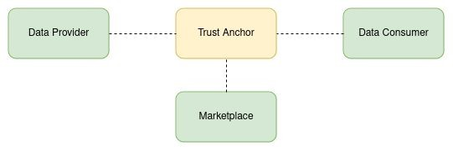
The Data Space
Participants will fulfill various roles
Data Provider
Data Consumer
Marketplace
Trust Anchor(s) to ensure trust between the participants

Slide 6
The Trust Anchor
Responsibilities:
provides the capabilities to identify participants
ensures independence from single participants
often seen as part of the “Data Space Operator”
Data Space should define criteria for participation
might provide capabilities for on-boarding
various options:
single Trust Anchor
centralized
decentralized
multiple Anchors for different interactions
has to participate in the authentication between participants

Slide 7
Authentication in a FIWARE Data Space
Based on Decentralized Identifiers and Verifiable Credentials
Decentralized Identifiers:
new type of identifier, that enables a verifiable, decentralized identity
the identifier can be resolved to a did-document that can express:
verification methods
cryptographic material
services to prove control of the did
examples:
did:key:zDnaeep661sHagxq47tMuJndWmmVngxEeaFmwD6uZzuoNDwSB - public key contained as part of the identifier
did:web:animalgoods.dsba.fiware.dev:did - did-document can be resolved through a well-known endpoint
Verifiable Credentials:
signed json-documents
can contain any information, trust depends on the issuer
combination of both allows decentralized, secure authentication in the Data Space

Slide 8
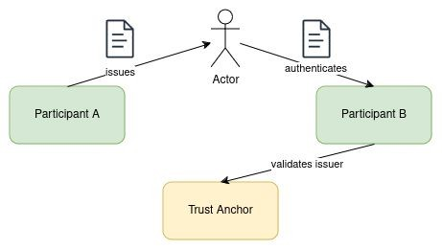
Authentication in a FIWARE Data Space
participants issues Verifiable Credentials to actors
VC contains claims about the actor, the participant or other informations
signed with the Decentralized Identity of the participant
Actor authenticates with the VC at another participant(using OID4VP)
receiving participant verifies the credential signature and checks the issuer at the trust anchor
API required from the Trust Anchor: EBSI Trusted Issuers Registry

Slide 9
The Data Consumer
wants to consume data from other participants or use their data services
has to be registered at the Trust Anchor
needs to properly authenticate
issue Verifiable Credentials to its actors
provide the right claims for user, service and purpose

Slide 10
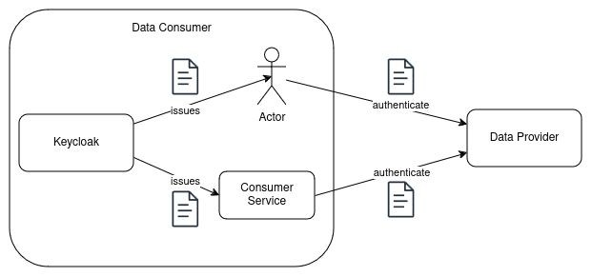
The Data Consumer
Keycloak as issuer of Verifiable Credentials - OID4VCI
credentials can be issued to users or services to act on behalf of the organization
claims per actor - allow fine grained definition of permissions for the actors
currently no additional requirements for a pure consumer

Slide 11
The Data Provider
offers Data or Services
wants to restrict access to participants of the Data Space
defines access policies and levels and enforces them
wants fine grained control about the access

Slide 12
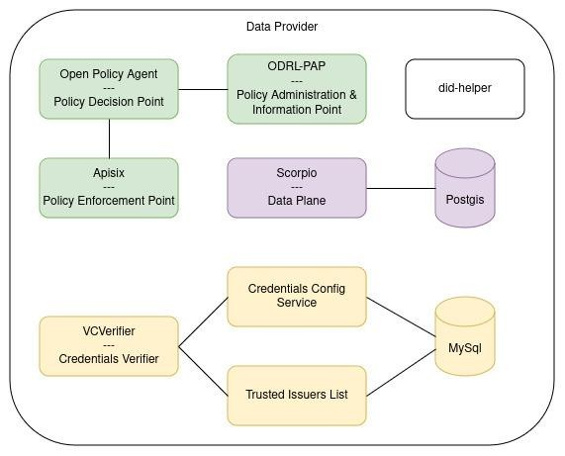
The Data Provider
Components for Authentication
Verifier
offers OID4VP compatible endpoints
verifies the signature of the credential
verifies that the issuer is a participant
verifies that only credential types and claims included that are allowed for the issuer
returns a JWT containing the claims
Credentials Config Service
allows to configure the responsible Trusted Issuers Registry and List
Trusted Issuers List
provides the allowed types and claims for the individual participant

Slide 13
The Data Provider
Components for Authorization
Policy Enforcement Point
entry point for all requests to data or services
requests decisions from the Policy Decision Point
Apisix used as PEP, can provide additional functionality like access logging, rate limiting
Policy Decision Point
decides about the request by evaluating the
policies and additional information
retrieves policies from the PAP
Open Policy Agent is used as PEP
ODRL-PAP
Policy Management based on ODRL
translates policies into rego and offers them to the PDP
allows extension with individual profiles

Slide 14
The Data Provider
Data Plane
typically an NGSI-LD compatible ContextBroker
can essentially be any service
currently only support for Rest-based communication, but other protocols are possible
not restricted to a single Data Plane

Slide 15
The Marketplace
provides a catalogue of available assets and services
supports contract negotiations
functionality to offer, sell and buy access to data and services

Slide 16
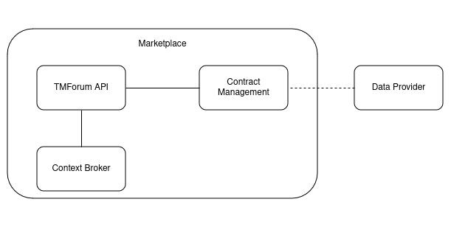
The Marketplace
TMForum-API implementations to provide a standardized API
Product, Offering etc. data stored inside the Context Broker
Contract Management listens for product orders and enables access at the Data Provider
Integrates with FIWARE Components like the BAE Marketplace

Slide 17
Slides
https://github.com/kyrylog/NOSC-UA

